Slide 1
Text to Speech Synthesis using Speaker Adaptation
Using end to end Deep Learning Model
Team Members: RITIKA MUGUNDAN 183002133
SHWETHA S 183002155
SAINITHYA S 183002140
VIGNESH V 183002182
SRIRAM R 183002164

Slide 2
Review I

Slide 3
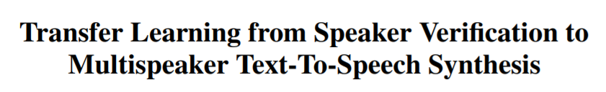
PROBLEM STATEMENT
We use a neural network-based system for text-to-speech (TTS) synthesis that is able to generate speech audio in the voice of different speakers, including those unseen during training.
We then adapt the network for a single speaker dataset.
Based on :

Slide 4
Literature Survey
1. Van Den Oord, Aäron, Sander Dieleman, Heiga Zen, Karen Simonyan, Oriol Vinyals, Alex Graves, Nal Kalchbrenner, Andrew W. Senior, and Koray Kavukcuoglu. "WaveNet: A generative model for raw audio." In SSW, p. 125. 2016.
2. Paine, Tom Le, Pooya Khorrami, Shiyu Chang, Yang Zhang, Prajit Ramachandran, Mark A. Hasegawa-Johnson, and Thomas S. Huang. "Fast wavenet generation algorithm." arXiv preprint arXiv:1611.09482 (2016).
3. Arik, Sercan O., Mike Chrzanowski, Adam Coates, Gregory Diamos, Andrew Gibiansky, Yongguo Kang, Xian Li et al. "Deep voice: Real-time neural text-to-speech." arXiv preprint arXiv:1702.07825 (2017).
4. Wang, Yuxuan, R. J. Skerry-Ryan, Daisy Stanton, Yonghui Wu, Ron J. Weiss, Navdeep Jaitly, Zongheng Yang et al. "Tacotron: Towards end-to-end speech synthesis." arXiv preprint arXiv:1703.10135 (2017).
5. Arik, Sercan, Gregory Diamos, Andrew Gibiansky, John Miller, Kainan Peng, Wei Ping, Jonathan Raiman, and Yanqi Zhou. "Deep voice 2: Multi-speaker neural text-to-speech." arXiv preprint arXiv:1705.08947 (2017).
6. Tjandra, Andros, Sakriani Sakti, and Satoshi Nakamura. "Listening while speaking: Speech chain by deep learning." Automatic Speech Recognition and Understanding Workshop (ASRU), 2017 IEEE. IEEE, 2017.

Slide 5
Literature Survey
7. Ping, Wei, Kainan Peng, Andrew Gibiansky, Sercan O. Arik, Ajay Kannan, Sharan Narang, Jonathan Raiman, and John Miller. "Deep voice 3: Scaling text-to-speech with convolutional sequence learning." (2018).
8. Shen, Jonathan, Ruoming Pang, Ron J. Weiss, Mike Schuster, Navdeep Jaitly, Zongheng Yang, Zhifeng Chen et al. "Natural tts synthesis by conditioning wavenet on mel spectrogram predictions." In 2018 IEEE International Conference on Acoustics, Speech and Signal Processing (ICASSP), pp. 4779-4783. IEEE, 2018.
9. Wang, Yuxuan, et al. "Style Tokens: Unsupervised Style Modeling, Control and Transfer in End-to-End Speech Synthesis." arXiv preprint arXiv:1803.09017 (2018).
10. Jia, Ye, et al. "Transfer Learning from Speaker Verification to Multispeaker Text-To-Speech Synthesis." arXiv preprint arXiv:1806.04558 (2018).
11. Li, N., Liu, S., Liu, Y., Zhao, S., Liu, M., & Zhou, M. (2018). Close to Human Quality TTS with Transformer. arXiv preprint arXiv:1809.08895.

Slide 6
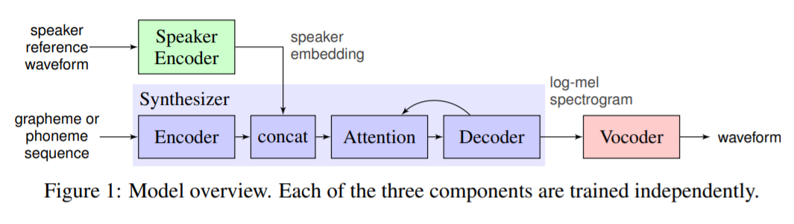
WHAT WE ARE WORKING ON

Slide 7
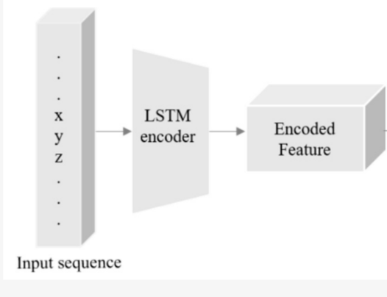
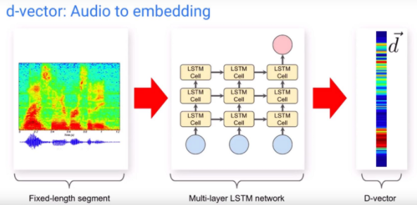
SPEAKER ENCODER

Slide 8
Speaker Encoder
It computes a fixed dimensional vector from a speech signal.
The network maps a sequence of log-mel spectrogram frames computed from a speech utterance of arbitrary length, to a fixed-dimensional embedding vector, known as d-vector.
Input 40-channel log-mel spectrograms are passed to a network consisting of a stack of 3 LSTM layers of 768 cells, each followed by a projection to 256 dimensions.
The final embedding is created by L2-normalizing the output of the top layer at the final frame, which is of the same size as the LSTM projection(ie 256 dimensional vector).
During inference, an arbitrary length utterance is broken into 800ms windows, overlapped by 50%. The network is run independently on each window, and the outputs are averaged and normalized to create the final utterance embedding

Slide 9
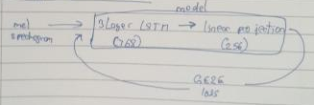
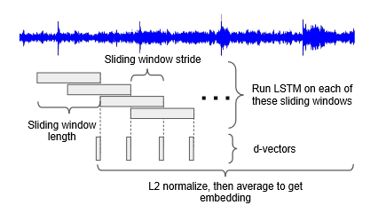
Training on arbitrary length speaker data

Slide 10
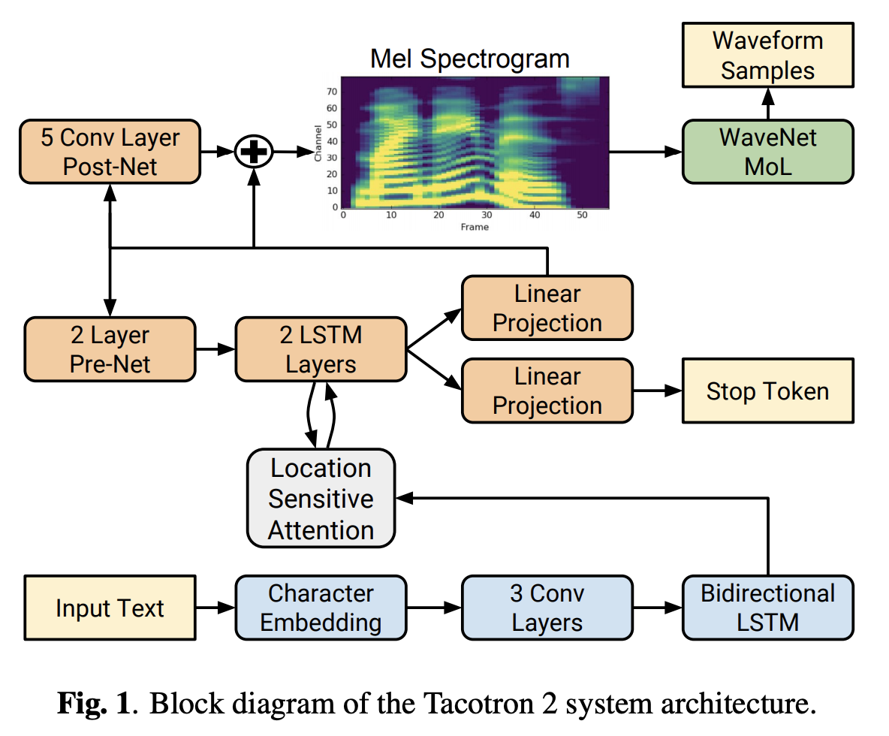
SYNTHESIZER

Slide 11
Synthesizer
It predicts a mel spectrogram from a sequence of grapheme or phoneme inputs using Tacotron 2 architecture
An embedding vector for the target speaker is concatenated with the synthesizer encoder output at each time step.
The synthesizer is trained on pairs of text transcript and target audio.
At the input, we map the text to a sequence of phonemes, which leads to faster convergence and improved pronunciation of rare words and proper nouns.
The network is trained in a transfer learning configuration, using a pre-trained speaker encoder (whose parameters are frozen) to extract a speaker embedding from the target audio, i.e. the speaker reference signal is the same as the target speech during training.

Slide 12
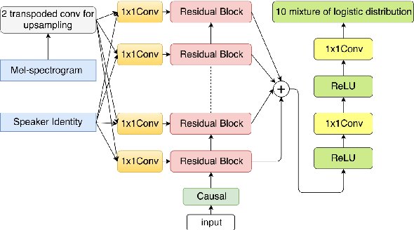
VOCODER
Architecture of Conditional WaveNet Vocoder

Slide 13
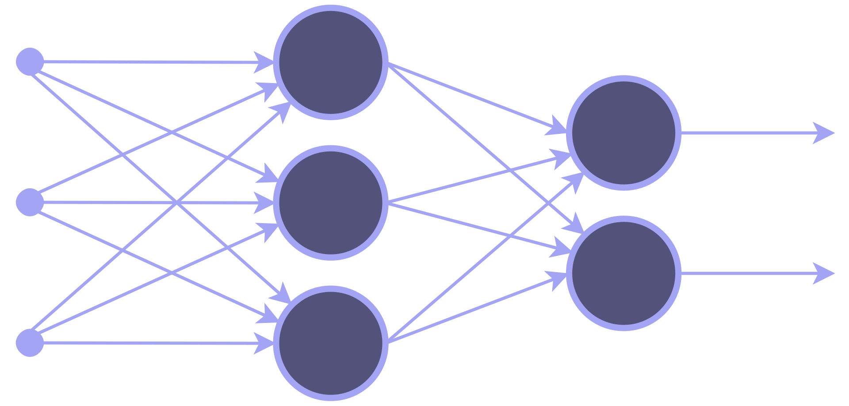
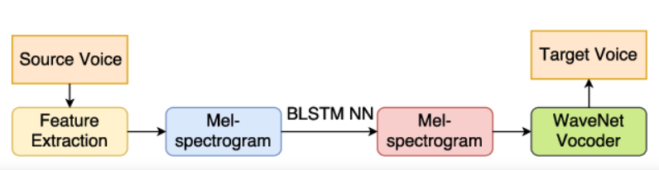
Vocoder
We use the sample-by-sample autoregressive WaveNet as a vocoder to invert synthesized mel spectrograms emitted by the synthesizer network into time-domain waveforms.
The architecture is composed of 30 dilated convolution layers.
The network is not directly conditioned on the output of the speaker encoder
The mel spectrogram predicted by the synthesizer network captures all of the relevant detail needed for high quality synthesis of a variety of voices

Slide 14
Experiment 1 - Training from Scratch
The work flow for the speaker synthesis (First Experiment)
For all our experiments, we are only training the synthesizer. Therefore we are making use of synthesizer_preprocess_audio.py, synthesizer_preprocess_embeds.py to preprocess our dataset. (Single speaker data from LibriSpeech). (Details on LibriSpeech in Slide 18)
We then train the synthesizer using synthezier_train.py
For testing we use the demo_toolbox.py file, where the original weights of the encoder and vocoder are used and the “from scratch” synthesizer weights are used.
Note: As we are trying to synthesize speech without any initialization, the first experiment is a speech synthesis task.

Slide 15
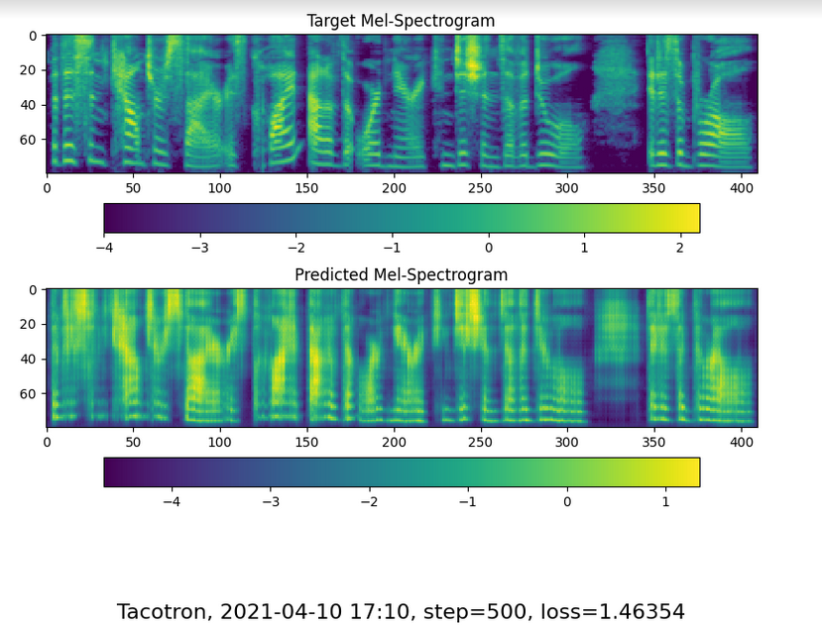

Training from scratch
Dataset:
13 minutes of a single speaker from Librispeech
Notes:
Step 10 [17.328 sec/step, loss=6.39061, avg_loss=9.23068]

Slide 16
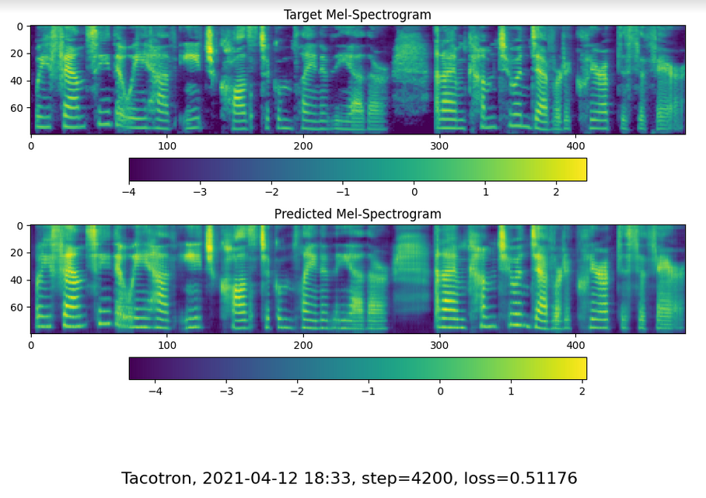
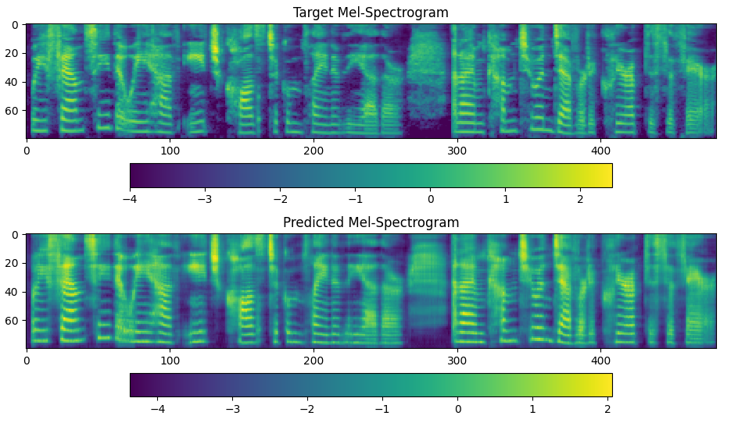

Slide 17
Experiment 2 - “Fine Tuning” the network
The fine tuning process for the speaker adaptation task (Second Experiment)
We load the pretrained weights from the github repo.(https://github.com/CorentinJ/Real-Time-Voice-Cloning)
(details about the pretrained network are mentioned in the following slide)
We loaded our network with these weights.
For all our experiments, we are only training the synthesizer. Therefore we are making use of synthesizer_preprocess_audio.py, synthesizer_preprocess_embeds.py to preprocess our dataset. (Single speaker data from LibriSpeech).
We then train the synthesizer using synthezier_train.py
For testing we use the demo_toolbox.py file, where the original weights of the encoder and vocoder are used and the “fine tuned” synthesizer weights are used.

Slide 18
Experimental setup of the Pre-trained Synthesizer (for “fine tuning”)
LibriSpeech is a corpus of read speech, based on LibriVox's public domain audiobooks.
The encoder, synthesizer and vocoder were pre-trained on the Librispeech - train-clean-100 corpus, which consists of 100 hours of clean speech from around 250 speakers.
The training details are mentioned for each sub-network below
Encoder: trained 1.56M steps (20 days with a single GPU) with a batch size of 64
Synthesizer: trained 278k steps (1 week with 4 GPUs) with a batch size of 144
Vocoder: trained 428k steps (4 days with a single GPU) with a batch size of 100

Slide 19
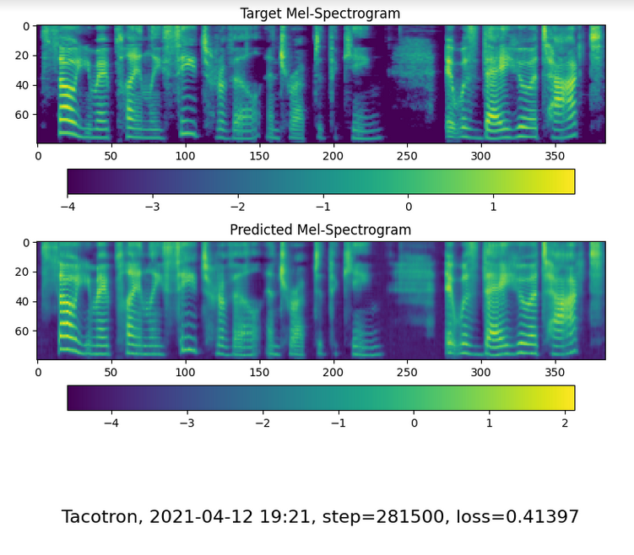
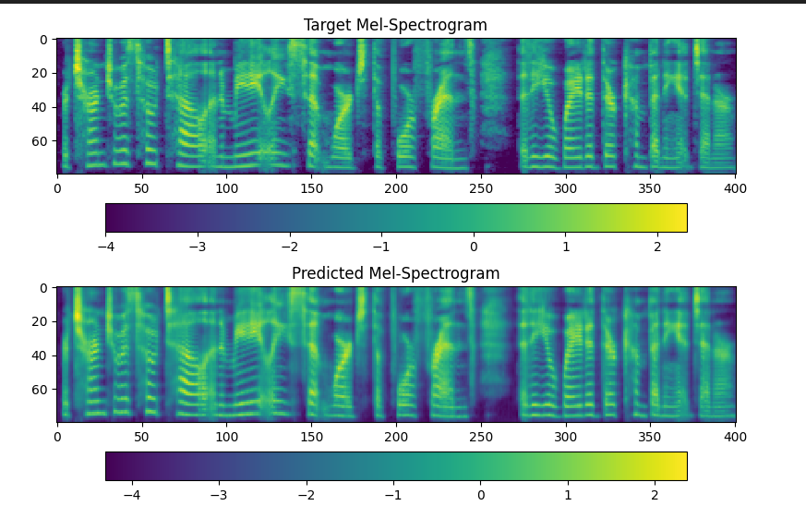
Fine Tuning the model
Dataset:
13 minutes of a single speaker from Librispeech

Slide 20

Testing
Before and after Fine tuning
Open the crate but don’t break the glass
Open the crate but don’t break the glass

Slide 21
Testing
Before and after Fine tuning
Oak is strong and also / gives shade
Oak is strong and also gives shade

Slide 22
Testing
Before and after Fine tuning
No one would have believed in the last years of the nineteenth century that this world was being watched keenly and closely
No one would have believed in the last years of the nineteenth century / that this world was being watched keenly and closely

Slide 23
This work demonstrates
After fine tuning, the synthesizer gets better at modeling the prosody and speech rate of the speaker.
Deficiencies with the synthesizer and its pretrained model can be compensated to some extent, by fine-tuning to a single speaker. This is much easier than implementing a new synthesizer and requires far less training.
A small dataset of 0.2 hours is sufficient for fine-tuning the synthesizer.
Better single-speaker performance can be obtained with just a few thousand steps of additional synthesizer training.

Slide 24
WHAT WE WILL BE DOING NEXT
Evaluate the results
Create our own dataset
Fine tune the synthesizer on our own dataset.
Second Review

Slide 25
THANK YOU

